Slide 1

Praktikum BioMedProg
Abschlusspräsentation Team C - Medical Image Analysis
Qiang Chang, Fabian Brain
31.08.2020

Slide 2
Agenda
1
The task
2
Implementation
3
Results
4
Conclusion

Slide 3
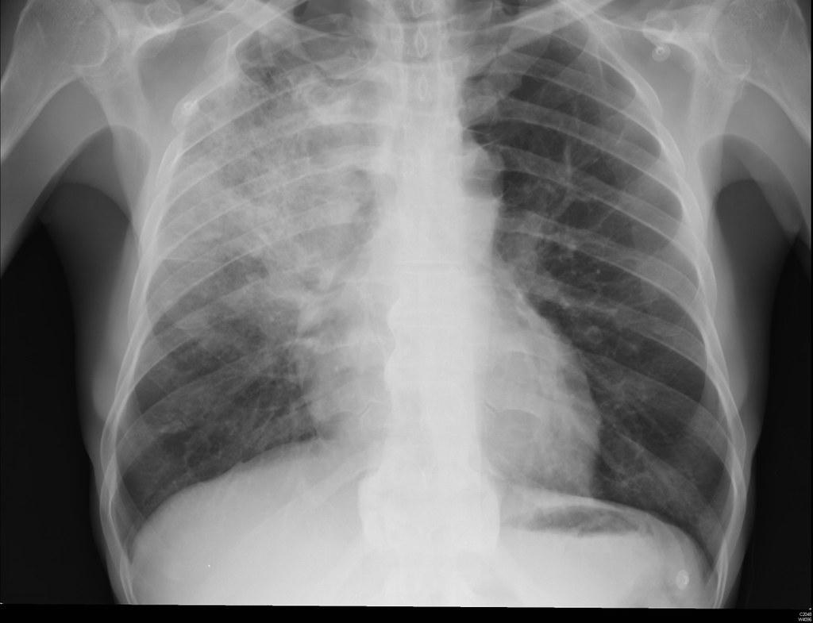
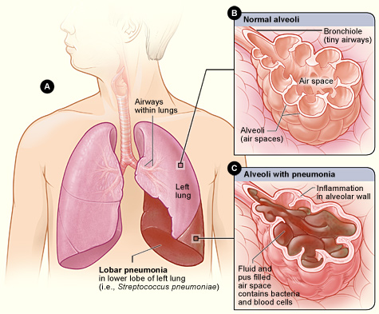
The task
Pneumonia Classification with X-Rays
Pneumonia:
Inflammatory condition of the lung.
Caused by infection with bacteria or viruses.
Affecting primarily small air sacs (alveoli).
Pneumonia affects
450 million people (7%)
Result in ~ 4 million deaths per year.
Fig.1
Fig.2
Fig.1: https://www.flickr.com/photos/pulmonary_pathology/7471755378
Fig.2: https://commons.wikimedia.org/wiki/File:Lobar_pneumonia_illustrated.jpg

Slide 4
Implementation
Framework:
PyTorch
API:
MONAI (https://www.monai.io)
Notes:
hier konnten wir vllt Ziel hinzufugen?

Slide 5
Implementation
Dataset analysis
Preprocessing
Model building
Training and evaluation

Slide 6
Implementation
Dataset analysis
Dataset:
2686 2D images Thorax X-Ray Scans (1024 x 1024 px)
Classes:
Normal (1341 x-rays)
Viral Pneumonia (1345 x-rays)
Dataset consists of both single channel (grayscale) and triple channel (RGB) images!

Slide 7
Implementation
Data preprocessing
Image preprocessing:
convert RGB to grayscale or the other way
DenseNet and ResNet require single channel grayscale
Inceptionv4 requires RGB
Resize
Augmentation (randomly rotate, flip and zoom)

Slide 8
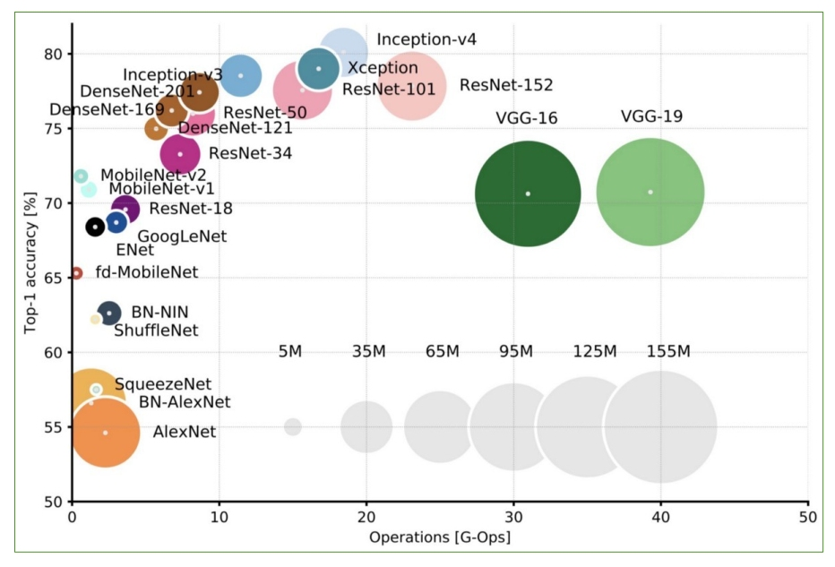
Implementation
Model building
Three different architectures:
DenseNet-121
Inception v4
ResNet-50
Two optimizers:
Adam
SGD

Slide 9
Implementation
Training and evaluation
Training:
Epochs: 200
Batch size: 48
Resize to 224 x 224 px
Learning rate: 0,0001
Validation:
3-fold cross validation
Evaluation metrics:
Loss
Accuracy
Sensitivity
Specificity

Slide 10
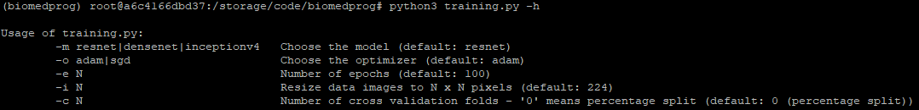
Implementation
How to run
Requires Python3 environment with pip package manager
Install the required packages as in the requirements.txt (pip install -r requirements.txt)
Adapt settings such as the dataset location in the parameters.py
See usage via python3 training.py -h
Example with DenseNet-121, Adam optimizer, 200 epochs and resize to 224px with 3-fold cross validation:
python3 training.py -m densenet -o adam -e 200 -i 224 -c 3

Slide 11

Results

Slide 12
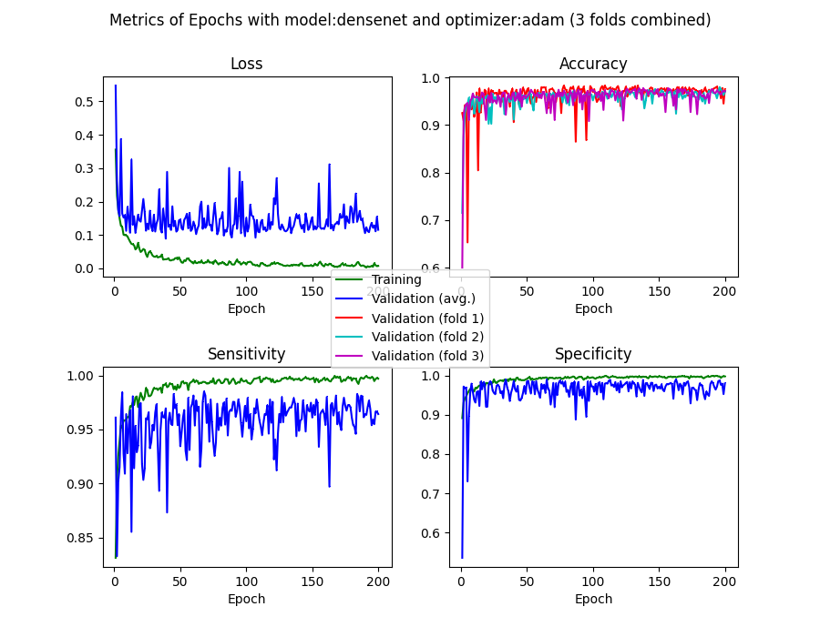
Evaluation metrics
DenseNet-121 with Adam

Slide 13
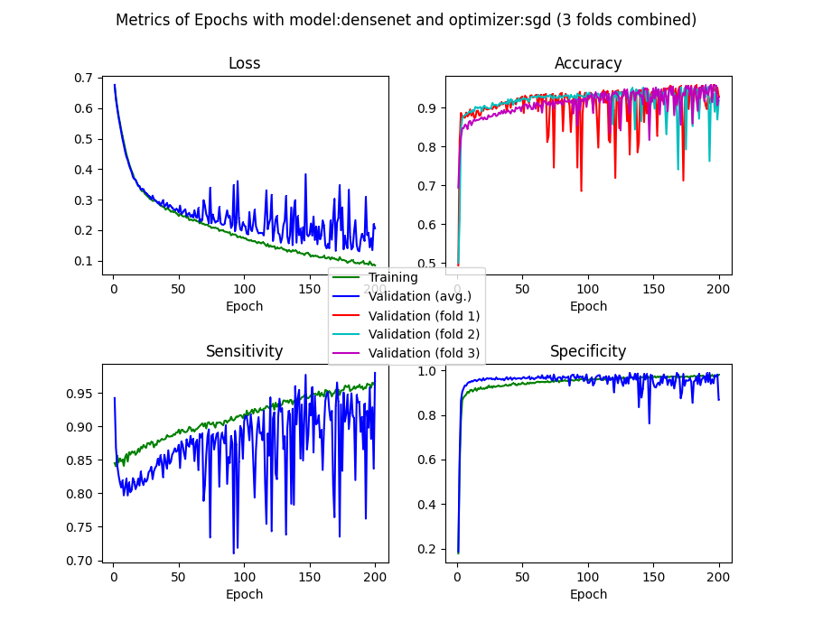
Evaluation metrics
DenseNet-121 with SGD

Slide 14
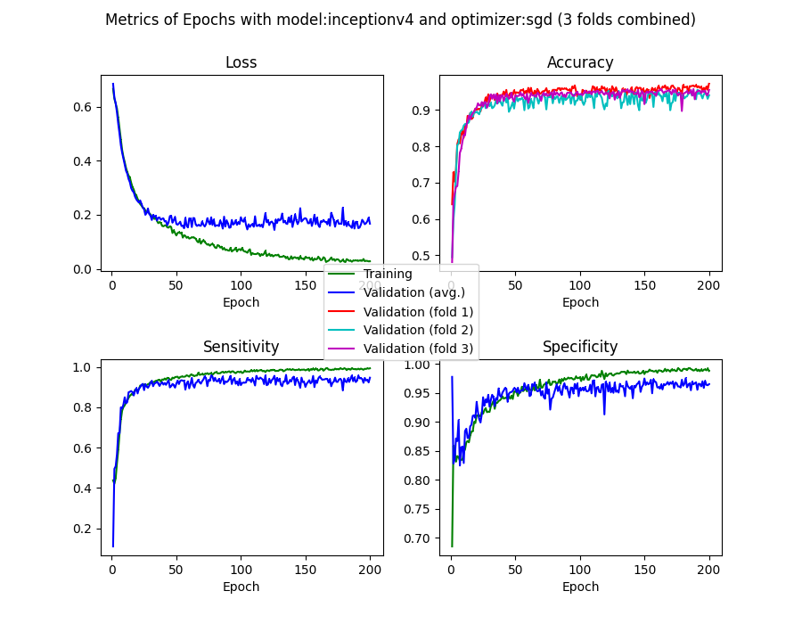
Evaluation metrics
Inception v4 with SGD

Slide 15
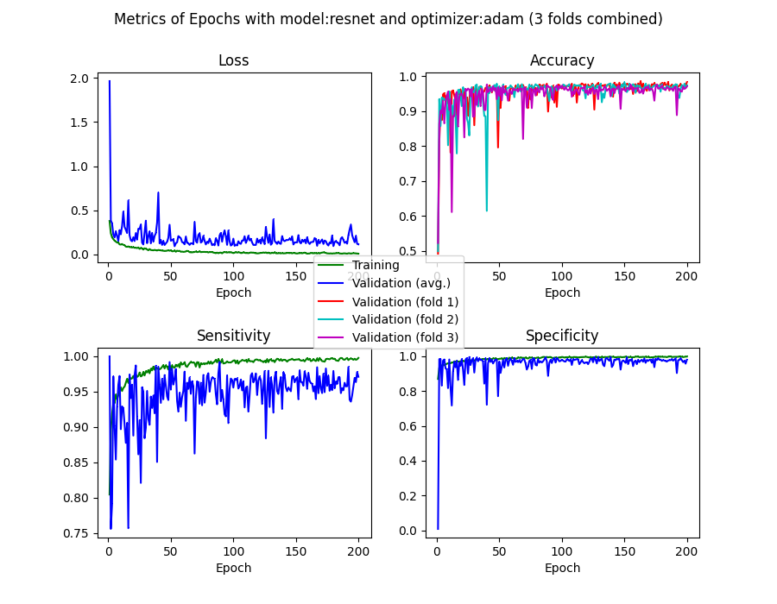
Evaluation metrics
ResNet-50 with Adam

Slide 16
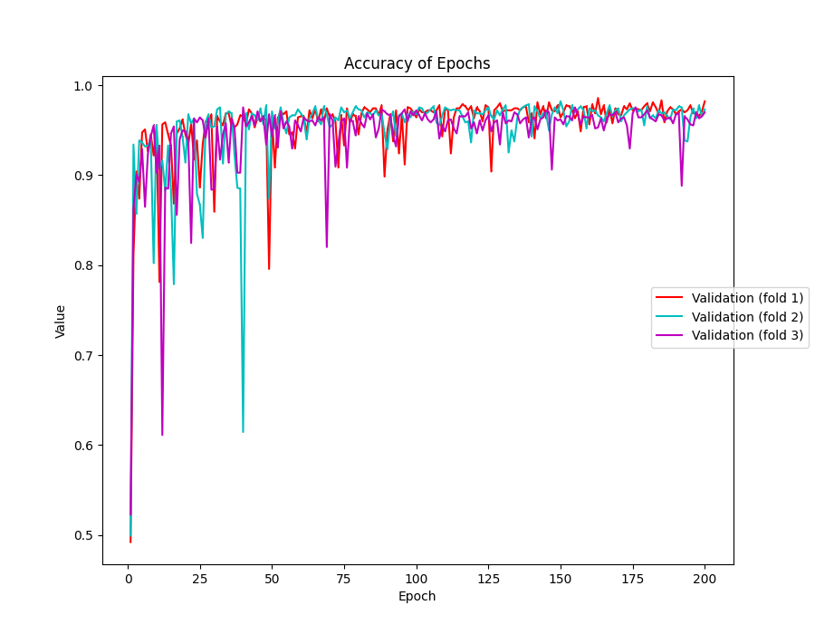
Evaluation metrics
ResNet-50 with Adam

Slide 17
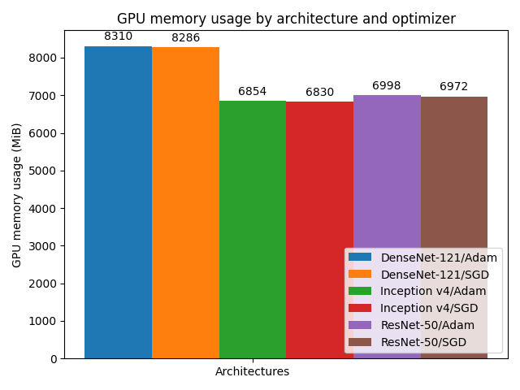
GPU memory usage

Slide 18
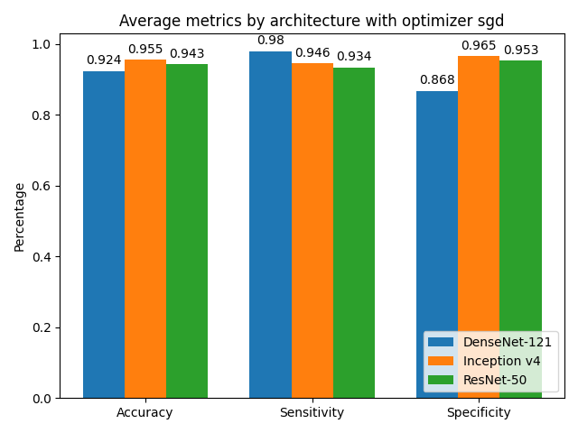
Results with SGD optimizer

Slide 19
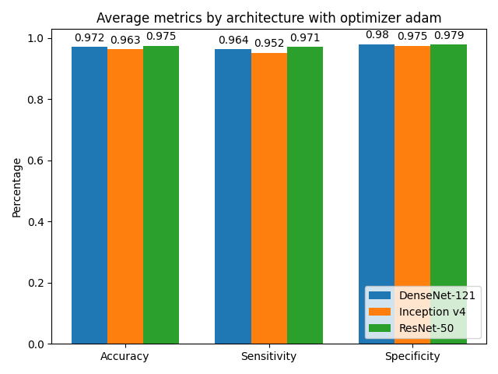
Results with Adam optimizer

Slide 20
Conclusion
DenseNet-121 with SGD is beginning to overfit after 75 epochs.
ResNet-50 with SGD is overfitting after around 150 epochs.
Adam is performing better than SGD.
ResNet-50 with Adam optimizer achieves the most stable results and overall the best performance.
Implementing the project was quite straightforward using PyTorch and MONAI. Only if you have to mix plain PyTorch with MONAI functions, for example during preprocessing, you have to be cautious regarding the data types of parameters and shapes and arrangement of matrices - they often do not match.

Slide 21
Thank you for your attention!

